Slide 1
Power BI @ the enterprise
Some challenges
Tom Martens @ MSFT Data Platform Community Hamburg
2023-01-11

Slide 2
Inside the box
Who I am
How to start with Power BI
Get organized
Done is (often) better than perfect
Governance – foe or friend?

Slide 3

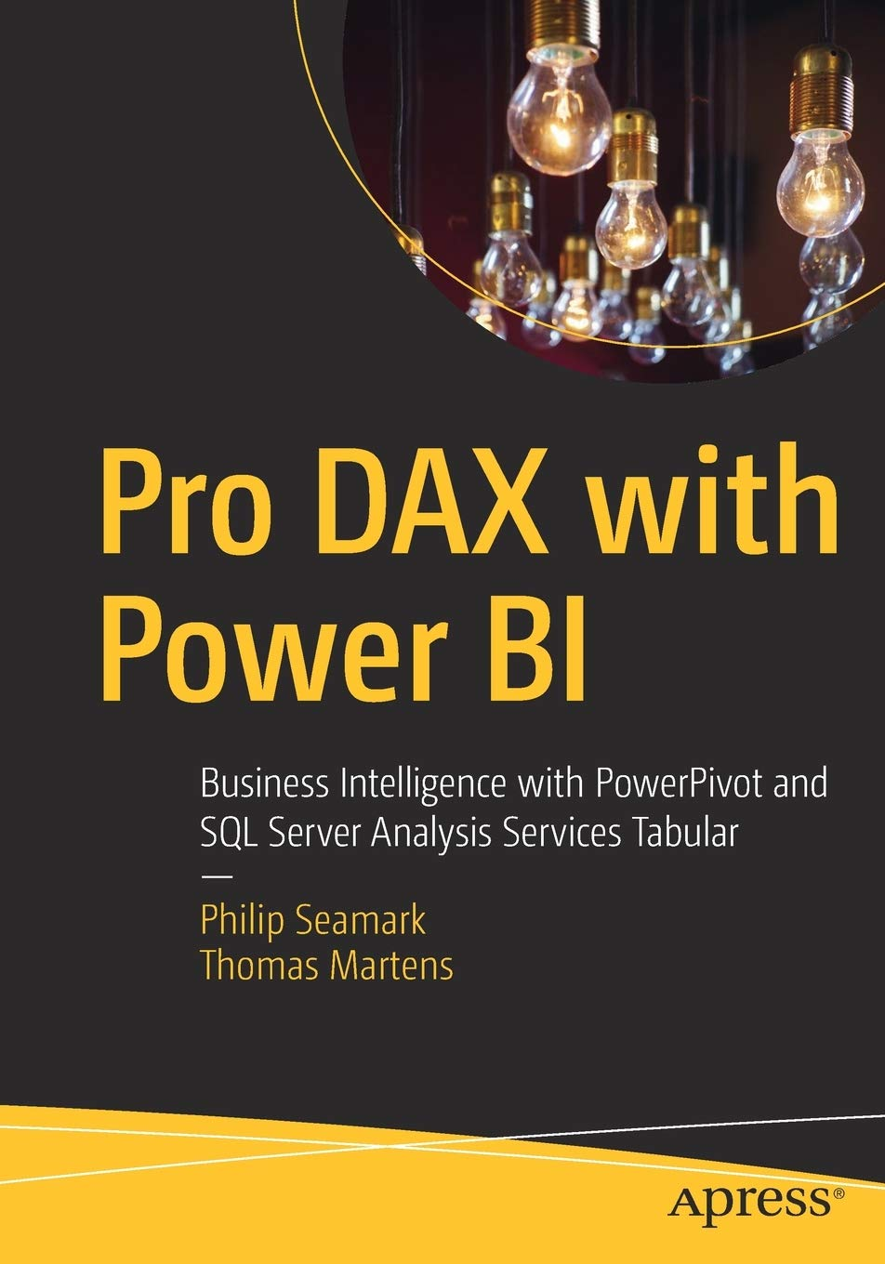

Tom Martens
25+ years of experience designing analytical solutions using the MSFT data platform
Solution Architect @ Munich Re
/tommartens68
@tommartens68

Slide 4

How to start

Slide 5
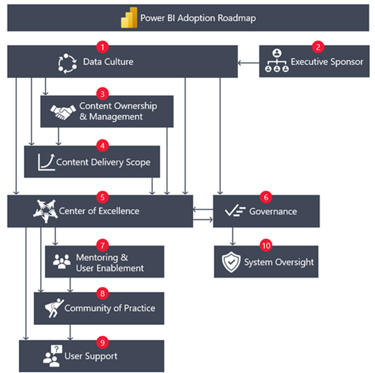
The journey begins here!
l
Power BI adoption roadmap - Power BI | Microsoft Learn

Slide 6

Get organized

Slide 7



Our (team) evolution
Power BI adoption roadmap - Power BI | Microsoft Learn

Slide 8

Done is (often) better than perfect

Slide 9



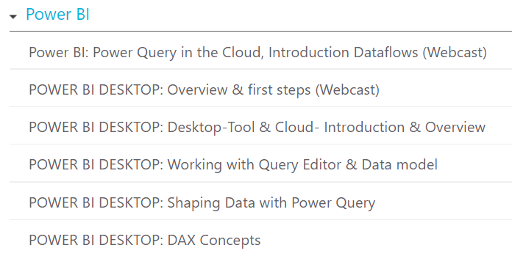
Enable the users
Assumption: You want to enable the Business users to create their own Power BI Solution, then it’s necessary that you
Enable the users from 2020 – 2022 we trained ~1500 users during ~200 training all seats for the 1st quarter are already booked The trainings are continuously updated new trainings are in preview

Slide 10
Enable the users
Assumption: You want to enable the Business users to create their own Power BI Solution, then it’s necessary that you
Enable the users
Create a community Use Yammer/Teams/Slack/… to create a community where users interact asking/answering questions

Slide 11
Enable the users
Assumption: You want to enable the Business users to create their own Power BI Solution, then it’s necessary that you
Enable the users
Create a community
Enable your IT support organization/team

Slide 12
Enable the users Challenges
The Power BI Team (the MSFT product group) is fast and the Power BI capabilities are growing
One of the greatest features added in 2022 is Gateway Security Roles
Offload work to your users, make datasource owners aware of the utilization
You have to be aware of the meaning of new features, some features require more maturity than others
If you consider yourself being an expert, your users are not (not now), help your users to
get their problem solved (not every data model is perfect, some reports have pie charts)
But ask the right questions (data growth, internal/external audiences, and some other important questions)

Slide 13

Governance a friend not a foe

Slide 14


Stay safe, but quick Challenges
Automate the provisioning of the Power BI toolset
Power BI Desktop installations (use the MSFT store)
Automate the Power BI licensing
Automate the creation of workspaces (don’t let users create their own workspaces)
Learn the Power BI Admin tenant settings, e.g. external sharing
Track what’s going on in your Power BI environment
…

Slide 15
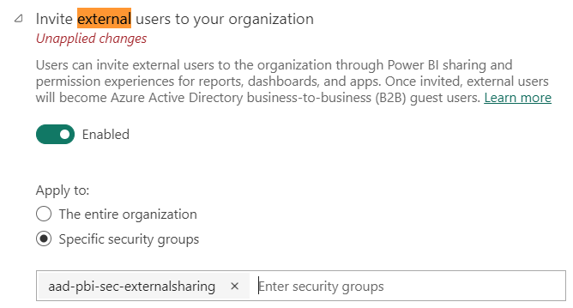
Stay safe, but quick Challenges
Learn the Power BI Admin tenant settings, e.g. external sharing

Slide 16
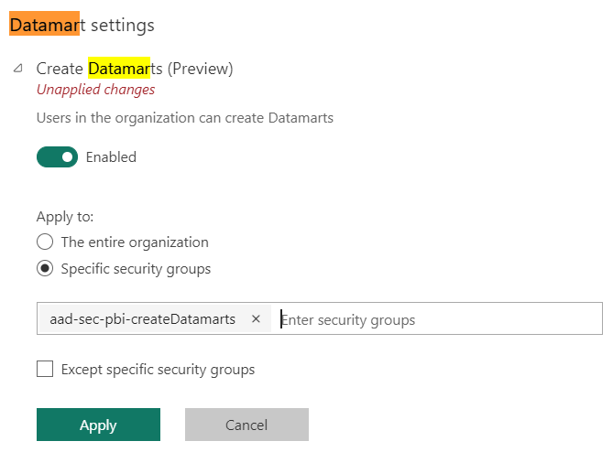
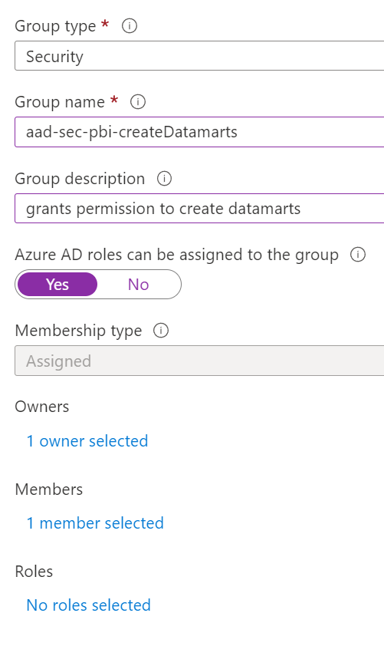
Stay safe, but quick Challenges
Learn the Power BI Admin tenant settings, e.g. feature enabling, e.g. datamarts

Slide 17
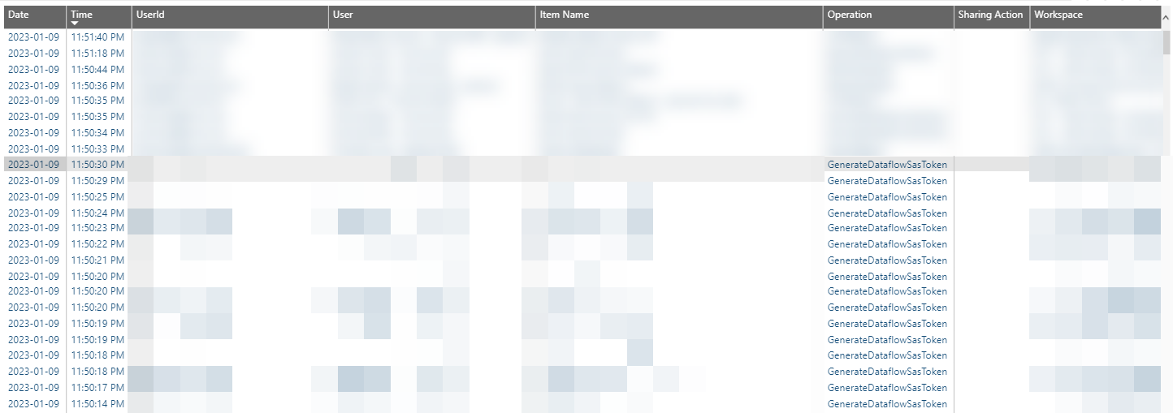
Stay safe, but quick Challenges
Track what’s going on in your Power BI environment using the activity logs

Slide 18

Numbers

Slide 19
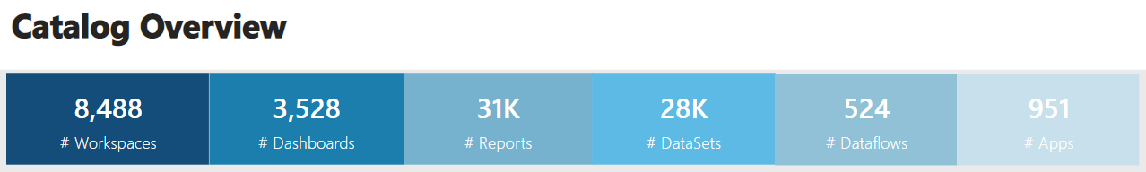
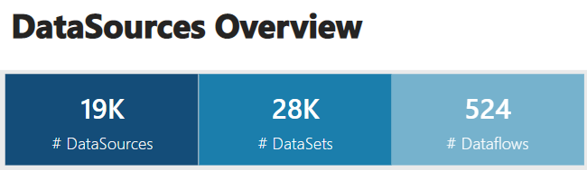
Some Numbers
We are not done yet ☺

Slide 20
Thank you

